Slide 1
User Onboarding
Best Practices

Slide 2
What is User Onboarding?
User Onboarding is a process that starts from the very ﬁrst welcome email & ﬁrst run experience, and can span over several months (depending on the product) to keep the customer continue using your SaaS app and receiving value from it.
You’ve seen it before, it’s that guided tour the SaaS app brings you through the ﬁrst time you actually use the product.

Slide 3

“Onboarding isn't about installing training wheels, it's about getting people to ride without them.”
— Samuel Hulick, useronboard.com

Slide 4

There are many diﬀerent Onboarding’s type

Slide 5
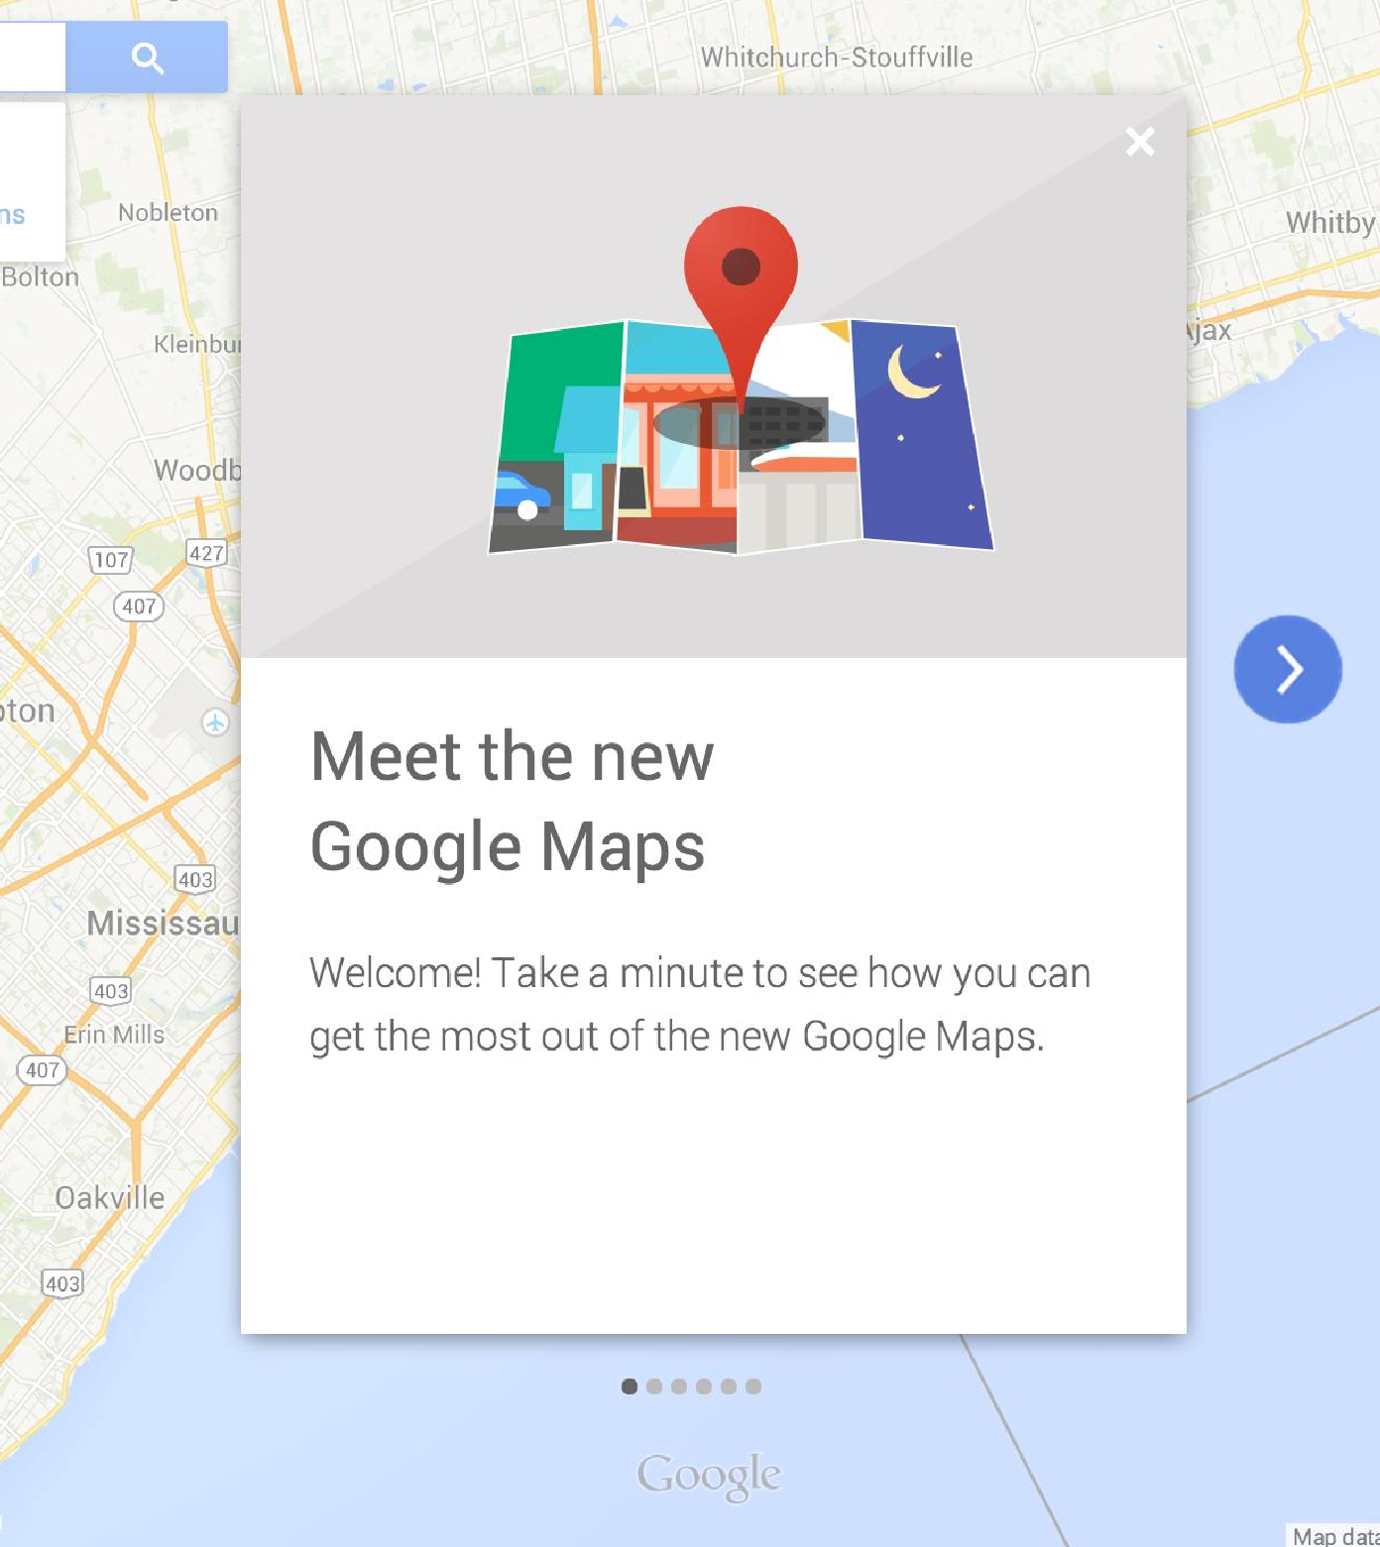
Slider Explanation
+ Clear and Compact message
+ Global POV / Product Philosophy
+ Easy to produce
+ Lightweight product presentation

Slide 6
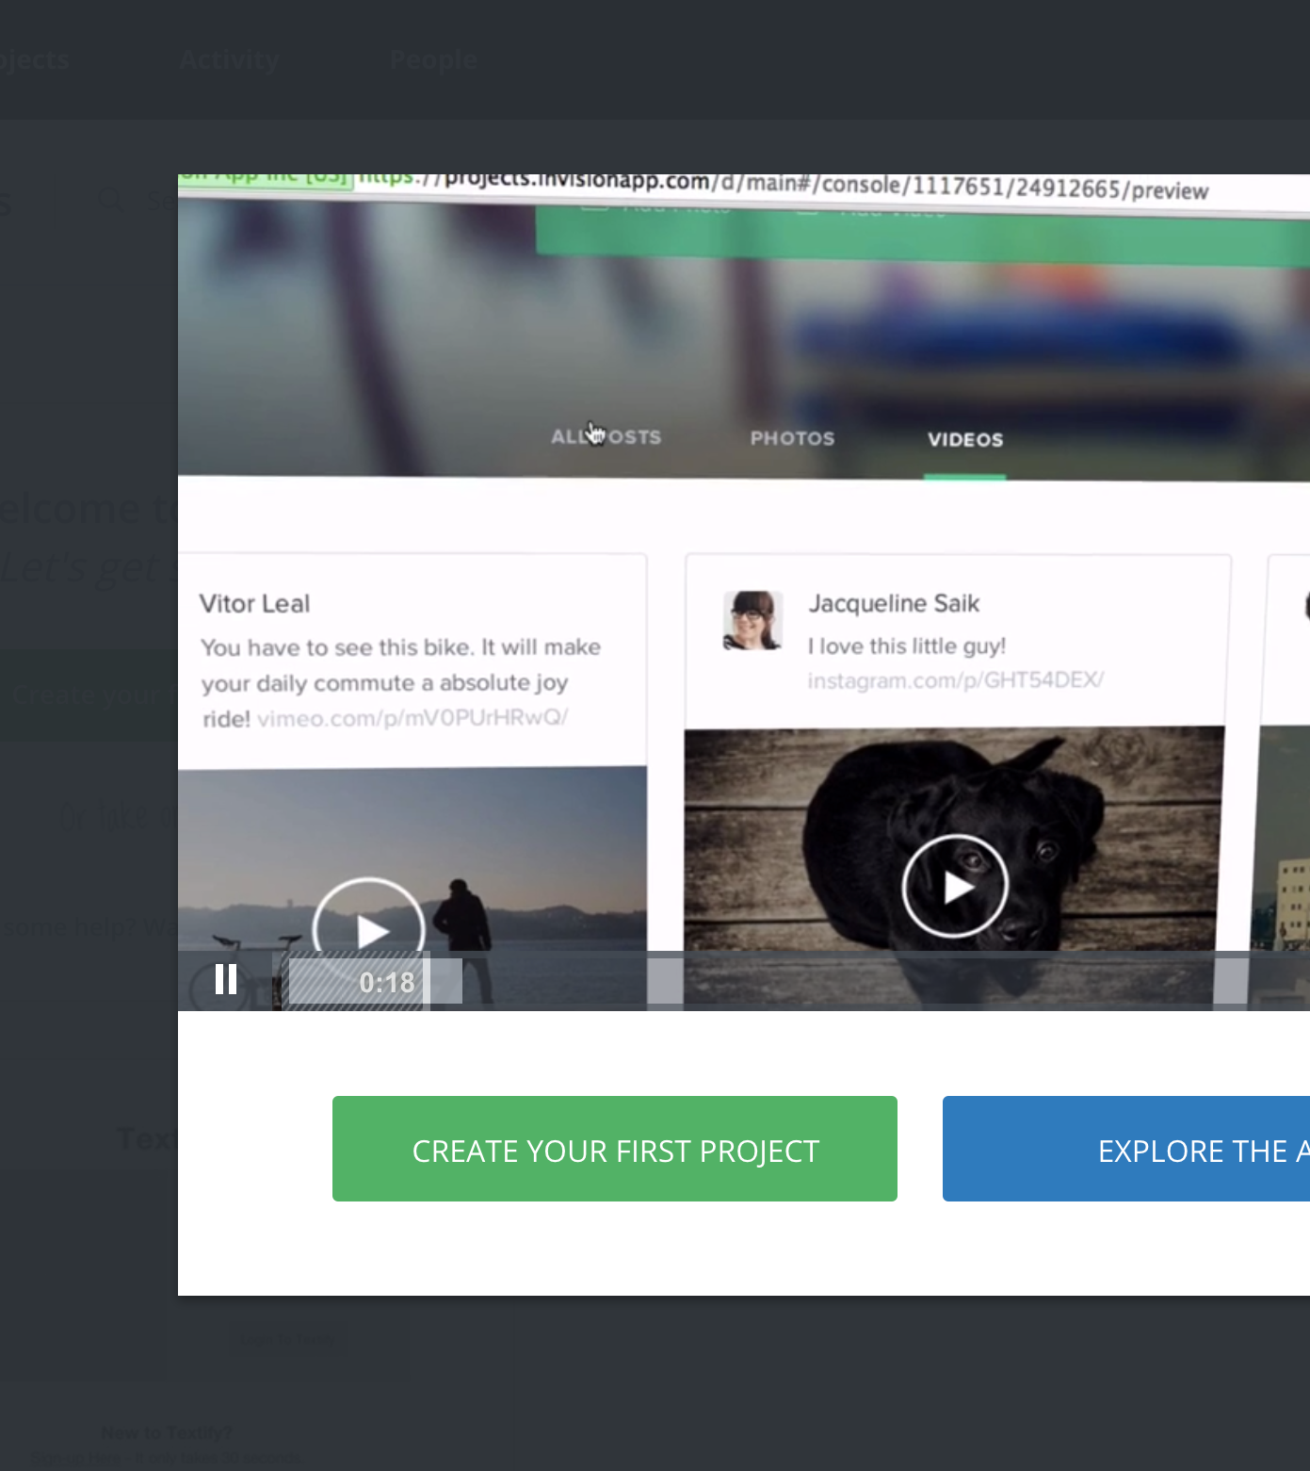
Video Onboarding
+ Easy to produce
-
Very often boring for the users (too long, not well articulated...)
-
You don’t necessarily remember the explanation at the end

Slide 7
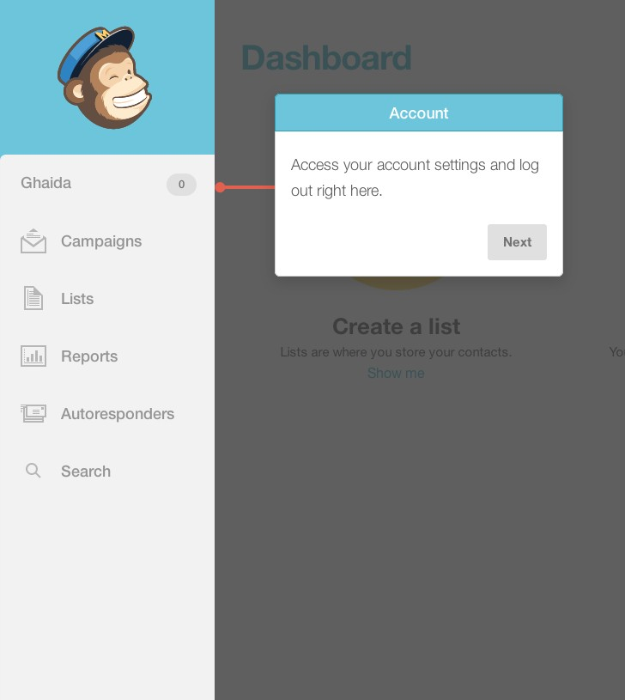
Interactive Tour / Joyriding
+ Step by Step on diﬀerent parts
+ Highlight with short explanation
+ Great way to teach people how to use features
-
Time consuming to maintain if we iterate

Slide 8
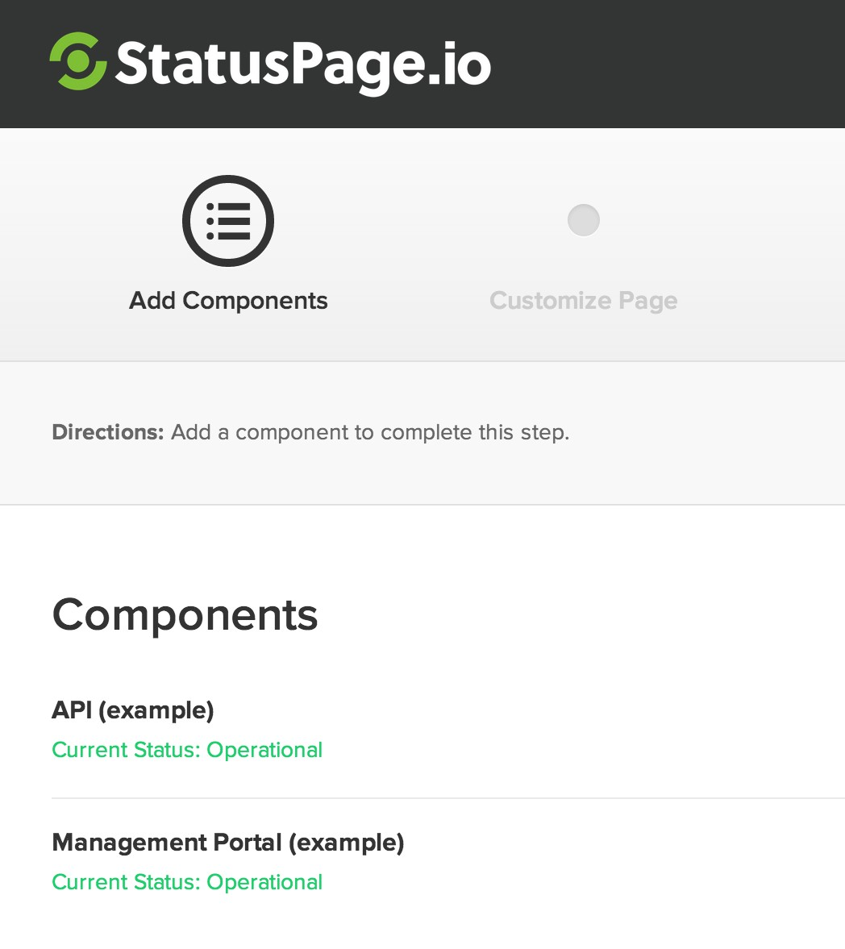
Setup approach
+ How install the SDK
+ Step by Step
+ Suggest a veriﬁcation checklist

Slide 9
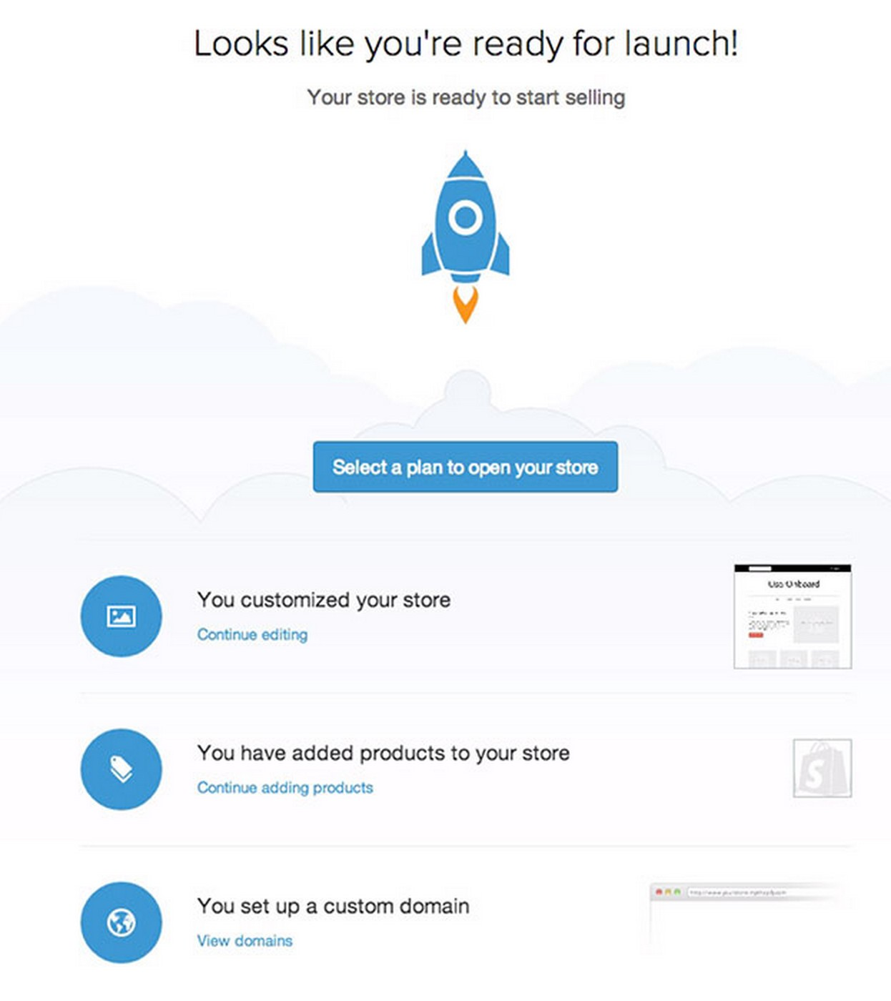
Empty States
+ Fake data
+ Components Preview
+ Engage user with call to action

Slide 10
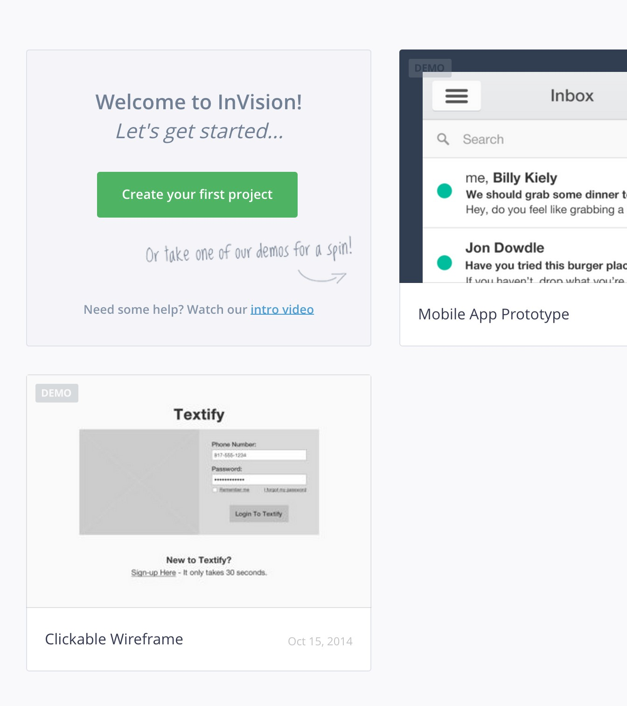
Demo Space
+ Let the user explore the diﬀerent interfaces
+ Great way to learn something alone

Slide 11
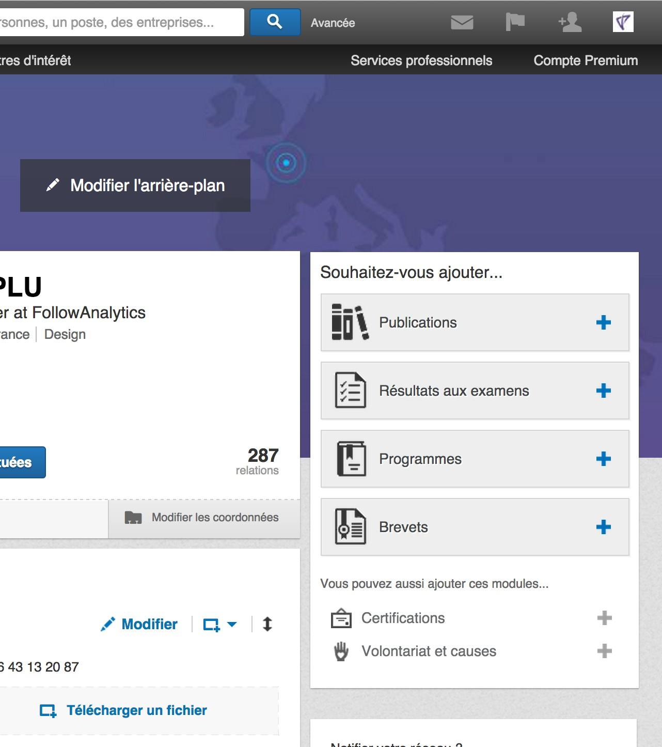
Continued Onboarding
+ Recommandations
+ Suggestions
+ Great way to keep the user on your product

Slide 12
Take Care
+ Let the user do it
+ Don’t teach all at once
+ Use fewer words
+ Remove noise
+ Create a clear, short & friendly copy
+ Engage user with call to action

Slide 13
What we really need Step by Step

Slide 14
Before Sign Up
•
Clearly show them what they need to do to start using the product
•
Let the user know how long (& easy) your signup process is
•
Collect as less information from the user as possible
•
Be friendly and notify user on what to expect after signing up
•
Once inside the application help the user to focus on things he needs to accomplish ﬁrst
•
Keep it less ambiguous as to what they need to do in the interface, by reducing clutter

Slide 15
When setting things up
•
Show early wins, help them achieve more frequent wins as they progress
•
Put things under-the-hood until they would really make sense
•
Add contextual help wherever you think a user might be mislead
•
Don’t be afraid to walk user down the lane or provide a help link for detailed guide or a quick help video to explain your setup process
•
Help user visualize the changes they conﬁgure
•
Generate excitement about using the product in the future
•
Teaches the user how to use the product by doing, not by words

Slide 16

“It’s always nice to be welcomed!”
— Samuel Hulick, useronboard.com

Slide 17
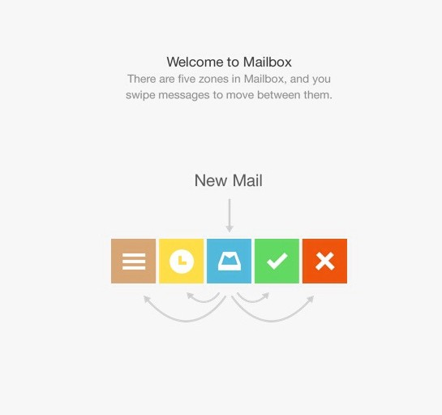
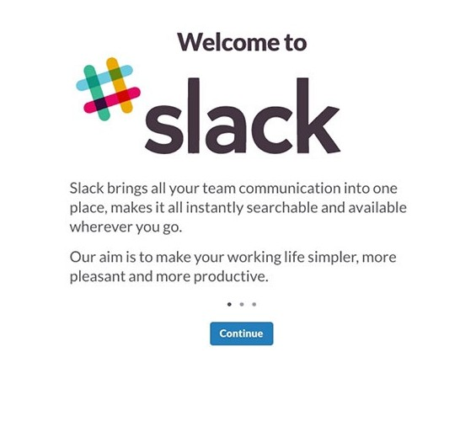
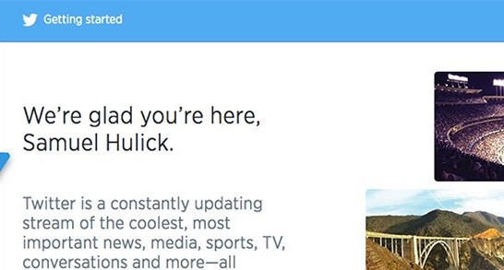
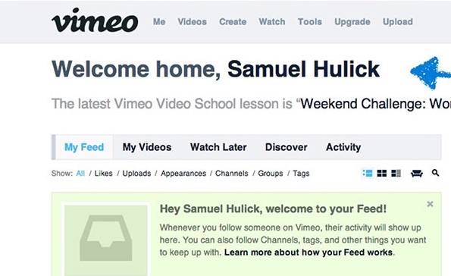
Examples
“We're glad you're here!”
“Welcome home, John Doe”
“Hey John Doe, welcome to your Feed!” “Welcome John Doe!”
“Welcome! Find something to play.”

Slide 18
Getting Started
•
What is the primary action(s) we want our user to take within the app?
•
What steps does the user need to take in order to reach that goal?

Slide 20
For returning user
•
Once in the application show a personalized action list
•
Help them resume aptly where they left before
•
Show them a list of items pending conﬁguration or enablement
•
Show them a progress bar to let them know how much they could achieve by doing more with the tool
•
Let them collaborate that they come back frequently

Slide 21
When introducing features
•
Add references to your valuable features at relevant places without disturbing the ﬂow of already enabled features
•
Try in-app notiﬁcations for highlighting individual features as they are rolled out
•
Send simple, elegant, descriptive emails to notify users of new features with embed videos or knowledge base links
•
Make it obvious for a user to ﬁnd your help content wherever they are (mobile, website, in-app, email)

Slide 22
Task – 30 Min
Take a website and design an onboarding experience for the website with the techniques discussed. For examples you can do it for a process of booking Flight on studentuniverse.com and/or expedia.com or Slack or any other scenario you like to do.

